Slide 1
Rendering the Whole Wide World on the World Wide Web
Kevin Ring
Analytical Graphics, Inc.
December 2, 2013

Slide 2
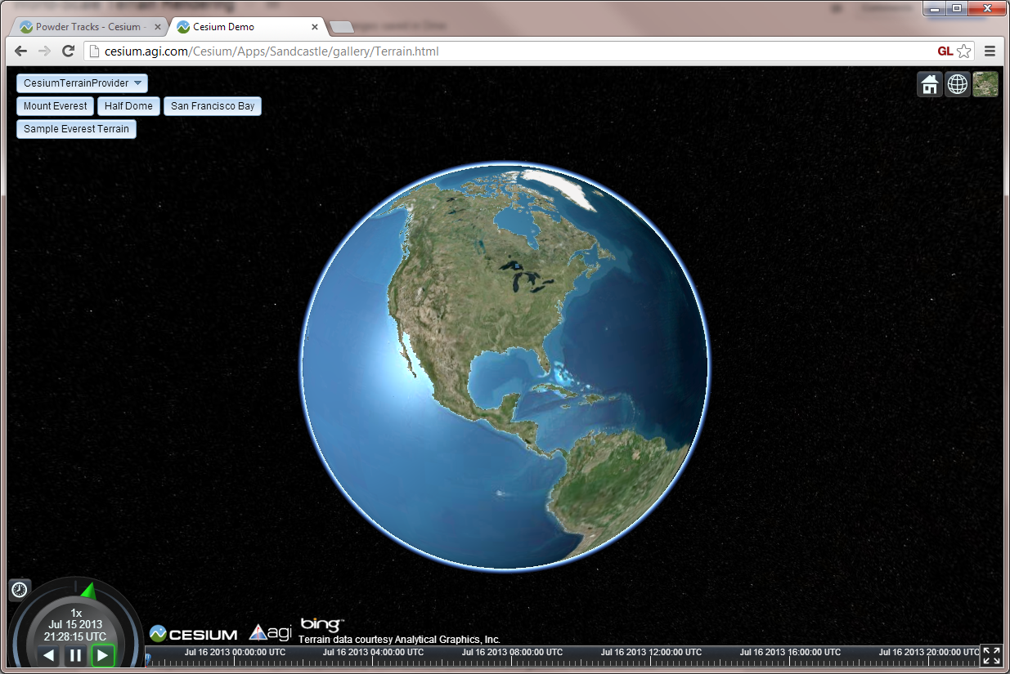
Massive Terrain Rendering

Slide 3
Cesium Platform
JavaScript, WebGL, Web Workers, Typed Arrays
Chrome, Firefox, Internet Explorer 11 (sort of)
Runs on Windows, Linux, Mac OS X, and Android
Notes:
As you may have noticed, Cesium runs entirely inside a web browser, and it doesn’t use any sort of plugin to do so.

Slide 4
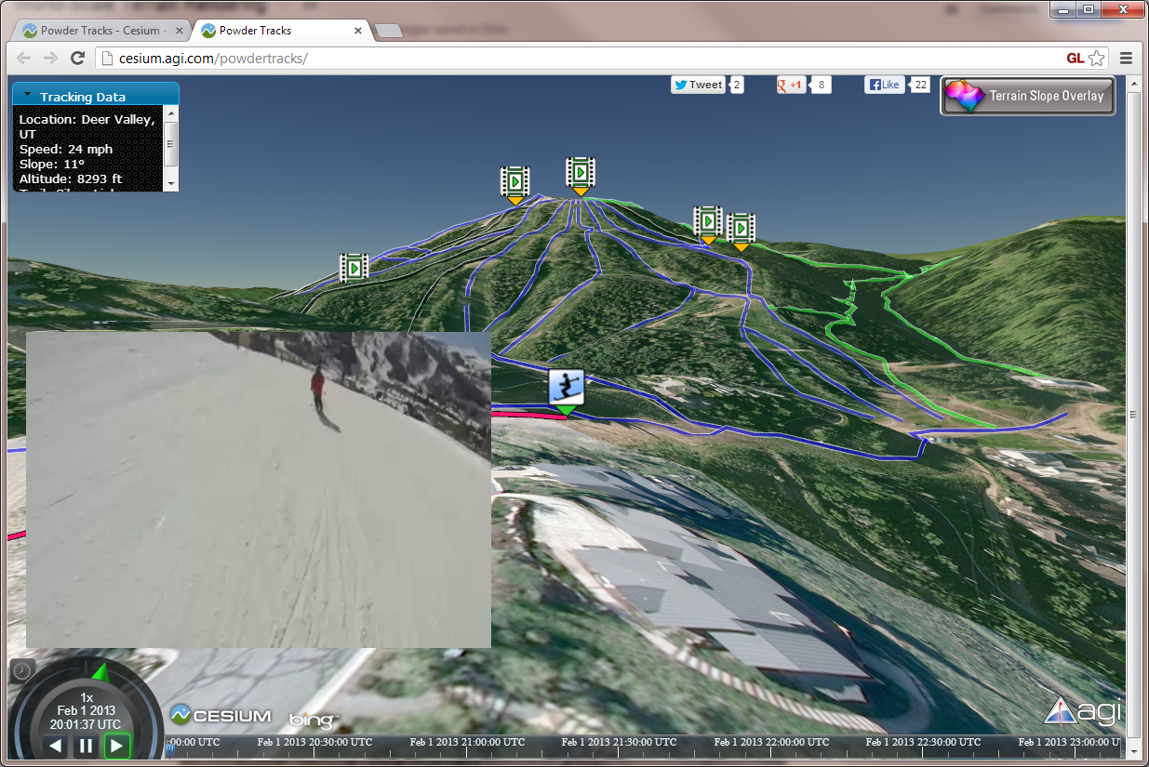
Powder Tracks demo
Notes:
Here’s a good example of the power of the web. This app uses Cesium for 3D visualization, but then overlays HTML5 video and other HTML elements to create an interactive experience and to hook into social media.

Slide 5
Terrain Rendering
Geometry or shape
Heightmap
Triangle mesh
Shading or color
Imagery (aerial photography, color map)
Various effects
Notes:
Terrain rendering is a well-researched area of computer graphics, with applications in games, scientific visualization, and synthetic vision.
There are two mostly-independent parts to effective rendering of the Earth’s surface. The first is the geometry or shape of the terrain. What is the terrain elevation at various points on the surface? Usually we represent the surface geometry using a heightmap or a triangle mesh, though more exotic things are possible.
Second is the shading or color of the surface. At a minimum, that usually means imagery, or what we might more generally call a color map. We can also apply various other effects to shade the surface, such as diffuse lighting and ambient occlusion, or even shade the surface by the terrain height or slope.
Procedural techniques for both terrain geometry and shading can be effective in games, but for virtual globes like Cesium, we’re almost exclusively interested in a realistic portrayal of the real Earth, and that means we need real data.

Slide 6
Earth data
Terrain and imagery collected by satellites and aerial instruments
Shuttle Radar Topography Mission (SRTM)
National Elevation Dataset (NED)
Landsat satellites
Digital Globe, SPOT, etc.
Terrain usually provided as a heightmap
Notes:
Terrain geometry data for large areas of the Earth is usually collected by flying satellites or aircraft over the area and bouncing a radar off the surface. This is a messy and expensive process, and one that is unfortunately outside my budget. A good example of this is the Shuttle Radar Topography Mission (SRTM), that obtained elevation data for most of the Earth’s surface with an instrument flying onboard the Space Shuttle Endeavor.
Similarly, imagery is collected by flying satellites and aircraft with fancy cameras. Satellite imagery in particular is a big business, and increasingly, companies like Google and Microsoft are flying their own aircraft to collect aerial imagery for use with their mapping applications. Individuals or smaller companies have a harder time getting access to such data.
Fortunately for us, the U.S. government has a long-standing policy of making the geospatial data that it owns freely available to the public. That includes excellent terrain datasets like SRTM and NED, as well as imagery datasets like Landsat scenes.
Terrain data is typically made available as a giant heightmap.

Slide 7
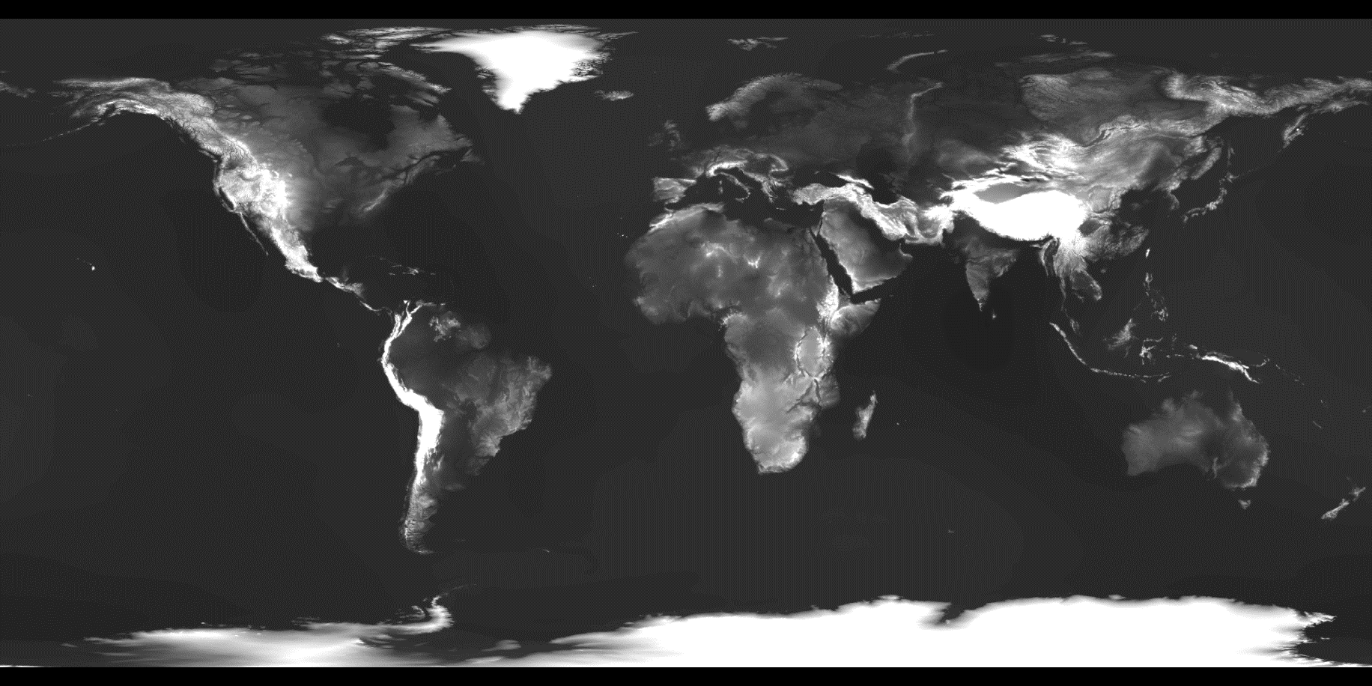
Heightmap
Notes:
If you’re not familiar with the term heightmap, it’s just a greyscale image like this one where the intensity of each pixel indicates the terrain height. Keep in mind, though, that these images are huge… starting in the gigabytes and easily going into the terabytes. They’re much too large to render directly, so we need some sort of level-of-detail algorithm.
As I mentioned before, the U.S. Government does a great job of making quality data, like SRTM, NED, and Landsat scenes freely available, if not easy to acquire. But…

Slide 8
Unfortunately…
The best data is hidden:
Within private networks
Within classified networks
Behind pay walls
By strict terms of use restrictions
Data is huge – up to hundreds of terabytes
We can’t access it ahead of time to transform it to a different form.
Notes:
… unfortunately, some of the best data is hidden within private and classified networks, or is only available for a fee. That means we can’t access it ahead of time to transform it to a different form for efficient rendering. To the extent possible, Cesium must work with existing sources of data, as they lie.

Slide 9





Terrain/imagery sources
Web Map Service (WMS)
Web Map Tile Service (WMTS)
Tile Map Service (TMS)
ArcGIS Map and Image servers
OpenStreetMap
Bing Maps
Google Maps
Notes:
And “as they lie” in the case of a web-based application like ours means remote servers that talk a variety protocols, like the ones listed here. Now the point here isn’t “hey look at all the great stuff we support.” Actually, if you look closely at this list, you may see one or two that we don’t actually support yet. The point is, we have to work with what we have. In many applications – games, especially – an asset pipeline is used to produce assets in a form that is ideal for the rendering engine. In Cesium, we may not even know what our assets are until runtime.
A typical Cesium application will include a terrain layer plus one or more imagery layers. And there is a lot of variability among these layers…

Slide 10
Layers are different
Different:
Map projections
Extents
Tiling schemes
May need on-the-fly adjustments:
Hue , saturation, gamma
Notes:
Different layers have different map projections, extents, and tiling schemes. Our rendering engine needs to cope with these differences on-the-fly. We also apply shader-based adjustments to the imagery on-the-fly. For example, when using Bing Maps imagery, we like to apply a gamma correction to brighten it up without washing out bright details.

Slide 11
Agenda
LOD algorithm – Chunked LOD
Processing terrain for rendering
Mapping imagery to terrain
Map reprojection on the GPU
Horizon culling
Notes:
So those are the unusual challenges faced by Cesium - unusual compared to something like a game, anyway. With that introduction out of the way, here’s what I’m going to cover.
First I’ll talk about the level-of-detail algorithm we use for terrain rendering. We use an algorithm called Chunked LOD.
Then, I’ll cover the server side. How do we process terrain data ahead-of-time for efficient rendering? And make it possible for our users to do the same with their terrain data, even though they can’t give it to us.
Next I’ll discuss what is – perhaps surprisingly – one of the more interesting aspects of Cesium’s terrain and imagery rendering engine. The process of mapping imagery from multiple sources, each with different projections, extents, and tiling schemes, to the terrain surface.
Related to that, I’ll discuss how we use the GPU to efficiently reproject imagery on-the-fly.
Finally, I’ll discuss how we do horizon culling. Horizon culling allows us to avoid rendering tiles that are below the horizon from a given camera viewpoint, and is an important optimization for rendering globe-conforming terrain. We have a fairly novel approach to this.

Slide 12
Agenda
LOD algorithm – Chunked LOD
Processing terrain for rendering
Mapping imagery to terrain
Map reprojection on the GPU
Horizon culling

Slide 13
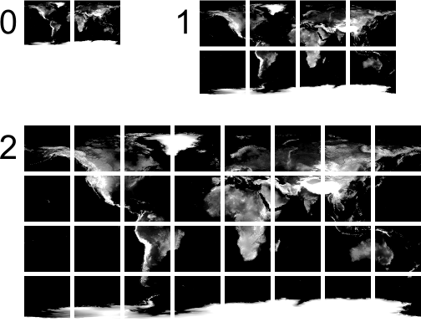
Chunked LOD
[Ulrich02]
http://tulrich.com/geekstuff/chunklod.html
Notes:
High resolution, worldwide terrain is, of course, much too large to render all at once. It’s comprised of billions or even trillions of triangles. Instead, we render a subset of it. To select the subset to render each frame, we use the Chunked LOD algorithm. This algorithm was presented by Thatcher Ulrich at SIGGRAPH back in 2002.
The algorithm assumes that the terrain data is organized into a quadtree of tiles as shown here. Every level has a representation of the entire world, but using a different number of tiles. At level zero, there are just two tiles. At level one, each of those tiles has four children, for a total of eight tiles.

Slide 14
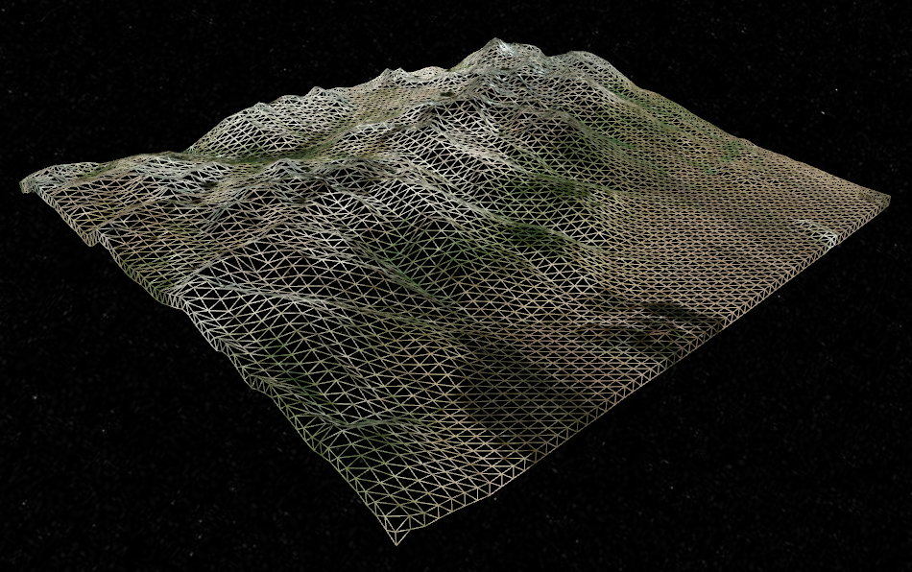
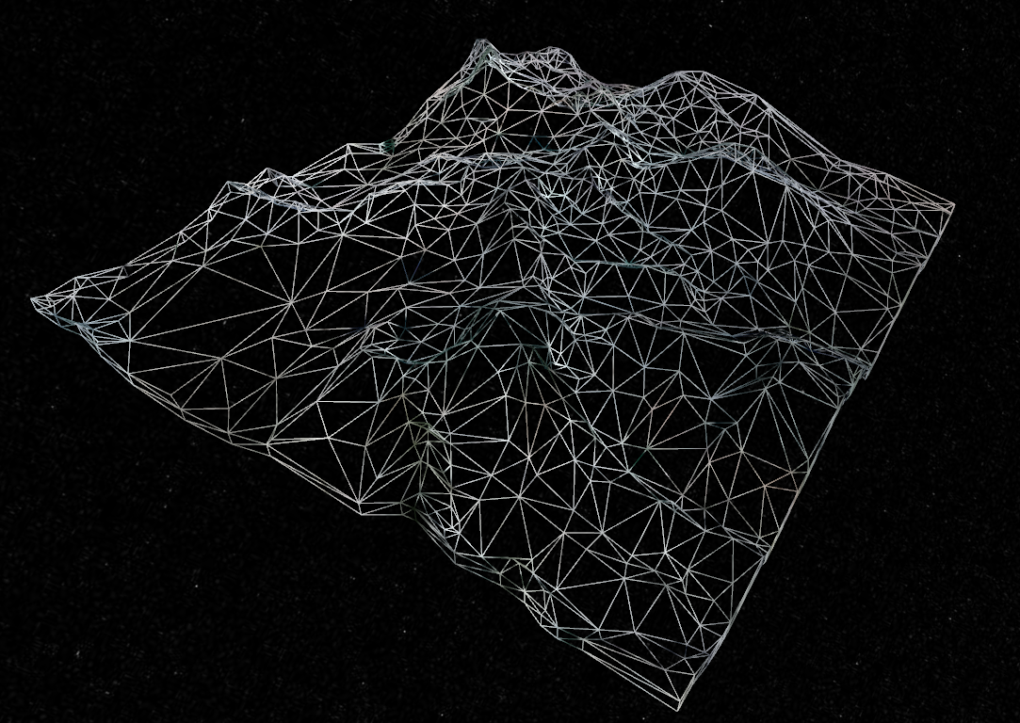
Tiles
Notes:
Each tile in our quadtree is a mesh covering a rectangular area in some map projection; usually a geographic or equirectangular projection in Cesium. If the terrain source is a heightmap pyramid, the mesh is a simple tessellation of the heightmap, as shown on the left. It can also be more irregular as shown on the right. Vertices of the mesh also contain texture coordinates, which are (0,0) in the southwest corner of the tile and (1,1) in the northeast corner. The coordinates change in proportion to the change in longitude and latitude over the tile, so they reflect a simple geographic projection.
The small, high-resolution tiles shown here look fairly planar, but we’re actually extruding terrain from WGS84, an ellipsoidal model of the Earth. With large tiles, the curvature becomes more apparent.

Slide 15
Chunked LOD pseudocode
If current tile meets screen-space error requirement
Add to render list
Else if all children are loaded
Recurse on visible children
Else
Queue not-yet-loaded children to load
Add to render list
Notes:
Here’s some pseudocode for the Chunked LOD at the core of terrain rendering in Cesium. It’s pretty straightforward. We start with the two tiles at the root of the quadtree and invoke this algorithm on each of them. First, we compute how much error, in pixels on the screen, would result if we were to render this tile. We’ll discuss how we compute screen-space error in a minute. If the error is low enough, maybe two pixels or less, we’ll add this tile to the list of tiles to be rendered and then we’re done with it.
Otherwise, we’d prefer to render this tile’s children, because they’ll have less error. But we can only do that if all four child tiles have been downloaded from the remote server and are resident in memory. In order to relax this restriction and render some child tiles but not others, we would need a way to clip out portions of the parent that overlap the rendered children. This gets tricky, so Cesium doesn’t try to do it currently. If all four children are loaded, we recurse, invoking this algorithm on each of the four children. We also do view-frustum and horizon culling here. If a child tile is outside the view frustum or below the horizon, we will not invoke this algorithm on it.
If the children are not loaded yet, we queue them to be loaded later, but in them meantime we continue to render this parent tile. The key idea here is that we must not pause rendering just because some data we’d like to have is not yet available. We render what we have, and when we get better data later the visual quality of the scene will improve.

Slide 16
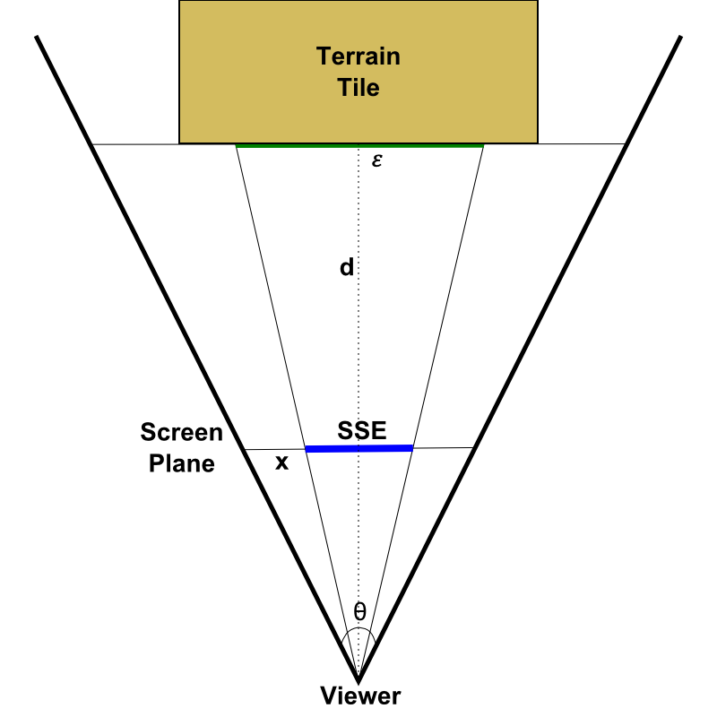
Screen-space error (SSE)
ε = geometric error of tile or level, in meters
x = width of the screen, in pixels
d = distance to tile, in meters
θ = camera field of view, in radians
Notes:
So what’s this screen-space error thing all about? Intuitively, we want to render tiles near the root of the quadtree for parts of the terrain surface that are far away, and render tiles deeper in the quadtree for parts of the terrain that are near the viewer.
More formally, we drive tile selection by estimating screen-space error using the equation shown here. This is a pretty standard equation used in level-of-detail algorithms. The width of the screen and the camera field-of-view angle are known quantities that generally don’t change from frame-to-frame. Epsilon is the geometric error of the terrain tile for which we’re computing the SSE. And d is an estimate of the distance from the camera to the tile, in meters.

Slide 17
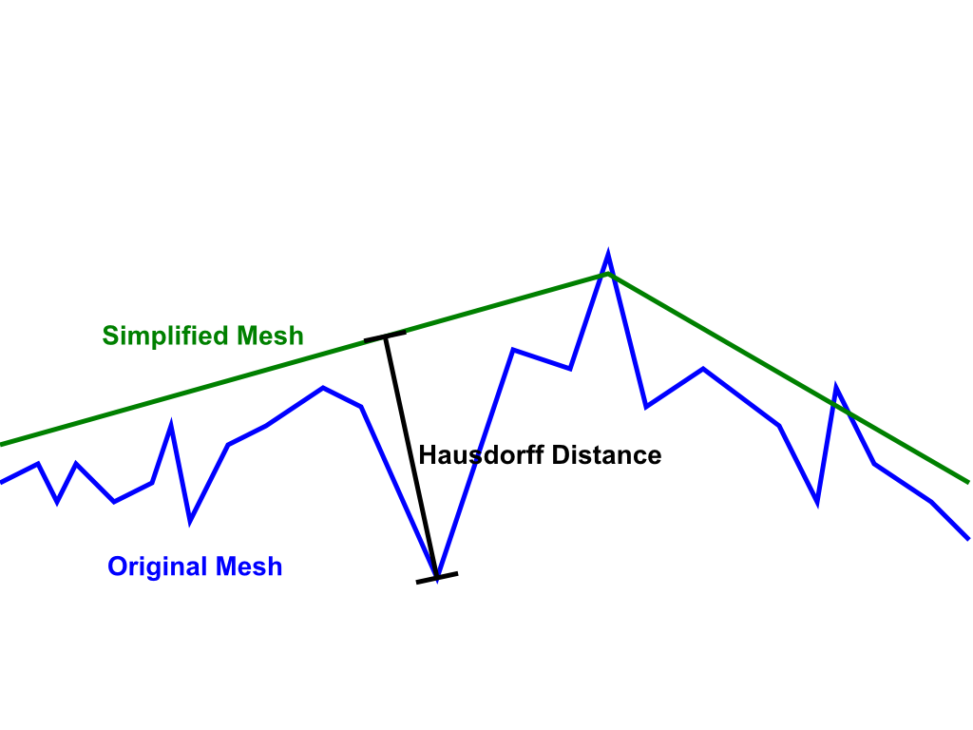
Geometric Error, ε
Geometric error is constant per level in the quadtree
[Klein96]
Notes:
Lets talk a little more about that epsilon quantity. Ideally, epsilon is the Hausdorff distance of the tile relative to the original, full-detail terrain in the region covered by the tile. Imagine we look at all of the points on the surface of the simplified mesh. For each of those points, we measure the distance from that point to the closest point on the original mesh. Then we do the same in reverse. For each point on the original mesh, we find the distance to the closest point on the simplified mesh. The greatest of those distances is the Hausdorff distance, and is an accurate measure of error in the simplified representation.
In practice, we may not be able to compute the Hausdorff distance precisely. In fact, in the case of heightmap-based terrain derived using a simple interpolation algorithm, we may not have an accurate error metric at all. In those cases, we simply choose a constant error value for each level in the quadtree so that we attain reasonable-looking terrain without rendering too many tiles. But we can’t make any guarantees about what screen-space error we actually achieve.
On the other hand, when we’re creating terrain tiles server-side for use by our rendering engine, we can target a particular geometric error while simplifying. I’ll talk more about how we do that in a bit. If we can put bounds on our geometric error, we can also put bounds on our screen-space error, and guarantee that our scene is geometrically accurate to within our screen-space error tolerance; usually one or two pixels.

Slide 18
Distance to tile, d
Accurate: distance to closest triangle
Simple: distance to bounding sphere
Balanced: distance to
Maximum height surface
East and West boundary planes
North and South approximate boundary planes
Notes:
The most accurate way to compute the distance to the tile is to compute the distance to each triangle in the tile, and then choose the smallest distance. That will be extremely expensive, however.
A much faster way to compute distance is to wrap the tile in some sort of bounding volume, and then compute the distance to that. We might end up estimating the distance to be slightly lower than it really is, and so end up refining a tile earlier than we need to, but it’s usually better to render some extra triangles on the GPU rather than spending a bunch of time on the CPU deciding whether or not we should render those extra triangles.
A very simple choice of bounding volume is a sphere. Unfortunately that gives us poor results. The problem is that, all too often, the viewer actually ends up inside the bounding sphere of a tile we’re considering rendering. When that happens, we have no way to estimate screen-space error – it is effectively infinite – so we have no choice but to refine.
The approach used in Cesium is to measure the distance to a composite volume formed from five surfaces. The first four are planes at the edges of the tile and aligned with the ellipsoid surface normal. The two planes on the Western and Eastern edges of the tile tightly bound the tile. But the planes on the Northern and Southern boundaries are approximations due to the surface normals at those boundaries not lying in a plane.
The fifth surface is a curved surface at the maximum height of the terrain within that tile. The distance to that surface can easily be computed by transforming the viewer position to a height above the ellipsoid and then subtracting the tile’s maximum height.
We saw a 5-15% reduction in the number of tiles rendered by switching from a bounding sphere to the five-surface approach.

Slide 19
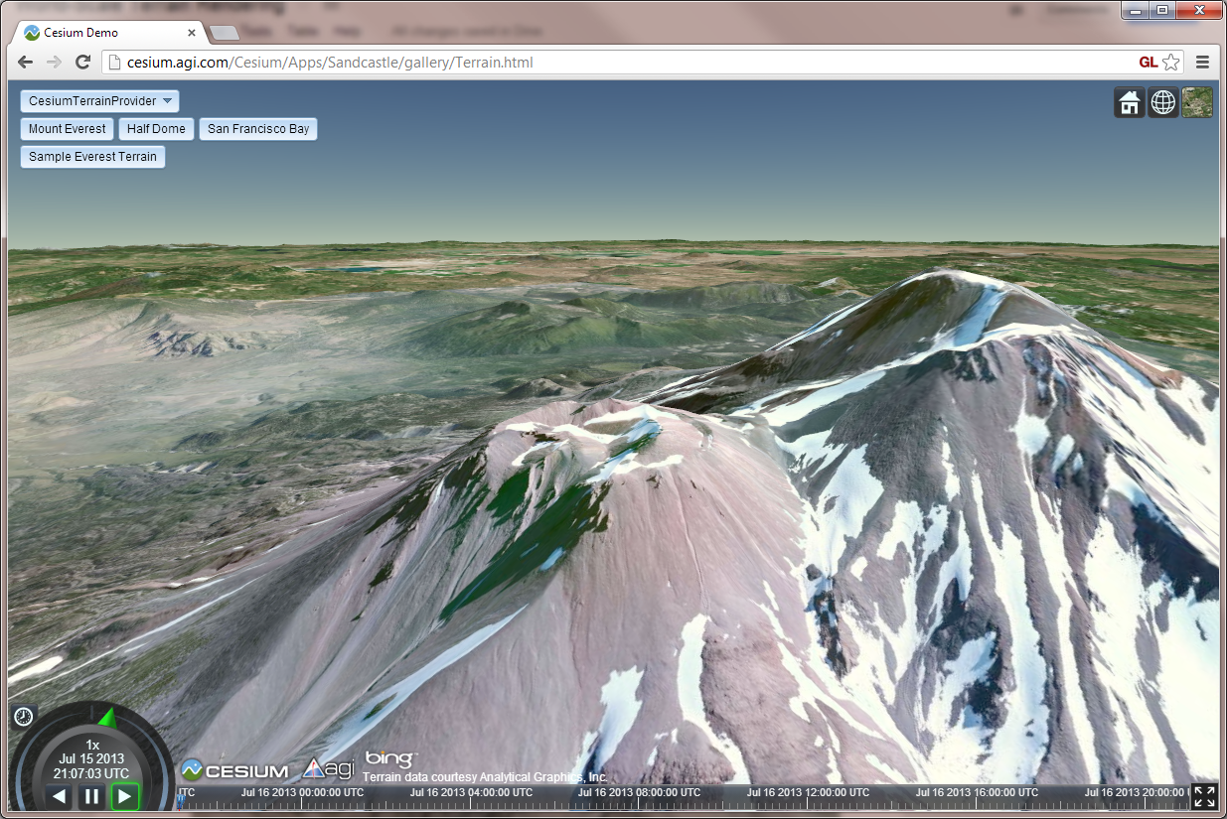
LOD Demo
Notes:
Now that you have some background on Cesium’s LOD algorithm, let’s take another look at Cesium itself and see it in action.

Slide 20
Agenda
LOD algorithm – Chunked LOD
Processing terrain for rendering
Mapping imagery to terrain
Map reprojection on the GPU
Horizon culling

Slide 21
Efficient rendering requires
Quadtree of tiles
Tiles with a reasonable number of vertices
A known geometric error for tiles in each level
Just one set of tiles
Stitching them together at runtime is expensive
Notes:
Now I mentioned before that Cesium is all about interfacing with terrain and imagery data “as it lies” rather than requiring some sort of asset pipeline to prepare it for rendering.
That’s true, and Cesium can interface with a variety of sources of terrain data, such as from an ArcGIS Server serving up heightmaps as if they’re just images, and we’ve even interfaced with Geoserver, an open-source WMS server. The main requirement is that the terrain be accessible as a quadtree of tiles, because, without that, any reasonably complicated terrain would be much too large to work with.
In addition, tiles must have reasonable geometric complexity. If each tile has too many vertices, the LOD algorithm won’t be able to put detail where it is needed without rendering so many triangles that the GPU can’t keep up. If tiles are too sparse, we’ll need to render so many of them that the number of tile rendered, and therefore the number of draw calls, will become prohibitive.
And we need to know the geometric error for each level in the quadtree, or at least a reasonable estimate for it. With terrain served as heightmaps from an ArcGIS or WMS server, we’re unlikely to know the actual geometric error, because it will vary from tile to tile. But we can estimate it and get reasonable results.
And finally, we need just one set of tiles. Cesium also prefers to work with a single tileset, because stitching them together at runtime would significantly increase the complexity and reduce the performance of the rendering engine. This is in contrast to our approach to imagery, where we can and often do combine multiple sources of imagery on the fly.

Slide 22
Terrain processing server
Make it easy to import terrain data
Offer an optimal (performance, visual quality) experience in Cesium
Currently geometry only – no imagery
Notes:
That is a fair number of requirements. And while they make sense to us as graphics people, our end users would rather not be bothered with thinking about it. They just want to see their terrain data in Cesium, and the easier we can make that the better. So we’re developing a terrain processing server in order to make it extremely easy to prepare terrain data for use with Cesium, and to create an end-product that Cesium can use to render the highest-quality and most performant terrain that we can manage.
Currently our server is only concerned with processing terrain, though. Imagery is less interesting because a number of servers and standards, like Tile Map Service (TMS) and Web Map Tile Service (WMTS) are already pretty much optimal for Cesium’s imagery needs. When it comes to terrain, there aren’t a lot of great offerings out there, so we’re making one.

Slide 23
Terrain tileset
Quadtree of tiles
Built from multiple input heightmaps
Ex: GTOPO30 1km for the whole world, SRTM 90m between -60 and 60 degrees latitude, and NED for the United States
Different max level in different areas
About 150 kilometers error at root level
Notes:
So the purpose of the server is to build a terrain tileset by mosaicking multiple input heightmaps, and optimize it for rendering by Cesium. For example, we might import GTOPO30 1 kilometer resolution data for the entire world, SRTM 90 meter between -60 and 60 degree latitude, and NED 3 – 10 meter in the United States. Because the tileset is created from multiple sources, each with a different resolution, the maximum level of the tile pyramid varies in different parts of the world.
In processing terrain for Cesium, we aim for the most detailed tiles to have a grid of approximately 64x64 vertices. The less detailed tiles, shallower in the quadtree, have only the vertices necessary to achieve the geometric error required at their level in the quadtree.
At the root of the quadtree, our allowed geometric error is about 150 kilometers. Each deeper level cuts that number in half. At level 18, the error drops below one meter.
We choose the geometric error to target at the root of the quadtree by estimating how much error would result in a hypothetical worst-case scenario where Mount Everest rises up out of the Mariana Trench, and our 64x64 grid places vertices on either side of the mountain, missing our aqueous Mount Everest entirely. The height error in that case would be about 20 kilometers. But interestingly, even in this absurd-sounding scenario, the curvature of the Earth has more impact on the error than the elevation extremes we’ve chosen. Taking the Earth curvature into account, the error is about 150 kilometers.

Slide 24
Processing pseudocode
If tile does not overlap source extent
return
If tile overlaps less than 64x64 source samples
Add source samples to tile
Else
Recurse on four child tiles
Aggregate four child meshes
Simplify combined mesh to geometric error target
Notes:
Here’s pseudocode for the process of incorporating a source heightmap into a tileset. We invoke this algorithm on the two root tiles of the quadtree. If one of those tiles does not overlap the source heightmap at all, we return without processing it. If it does, we need to decide if this tile should be considered a “deepest level” tile, or if we should proceed recursively by invoking this algorithm on this tile’s four children. In the latter case, we then combine the four child meshes produced by the recursive invocation, and then simplify them. We remove vertices that are not necessary to achieve the maximum geometric error required by this tile.
This algorithm is highly parallelizable because we can process each tile in isolation from the others. The only dependency is that parent tiles depend on their children.

Slide 25
Leaf tile
Notes:
Here’s how we add source samples to a leaf tile. First, we find all the source samples that are either inside the bounds of the tile, or just on the other side of the boundary. Then, we bilinearly interpolate four heights to find precise heights for each of the four corners of the tile, and linearly interpolate between two height to find heights on the edges. Finally, we connect the vertices together to form triangles.

Slide 26
Non-leaf tile
Notes:
Non-leaf tiles are a bit more complicated. First, we add the vertices of all four children to the tile.

Slide 27
Non-leaf tile
[Garland95]
Notes:
Then, we follow the method described by Michael Garland in his paper “Fast Polygon Appoximation of Terrains and Height Fields.” Initally, only the corner vertices are active. The rest are inactive. We compute a Delaunay triangulation of the simple mesh containing these four vertices, and then determine which of the two triangles contains each of the remaining, inactive vertices. If a vertex is on a triangle edge, it is assumed to be contained by both triangles. Then, we compute the distance from each vertex to the triangle that contains it and insert each triangle into a priority queue, sorted by the distance to its most distant vertex.
We select the most distant vertex in the highest-priorty triangle, activate it, and redistribute the vertices in the original triangle to the three new triangles that result from inserting the vertex

Slide 28
Non-leaf tile
[Garland95]
Notes:
The process repeats until the most distant vertex is closer to its containing triangle than the maximum geometric error allowed at this level.
You may remember earlier that I described the Hausdorff distance, which is a measure of both the distance from the triangles in the simplified mesh to the triangles in the original mesh, and the distance from the triangls in the original mesh to the triangles in the simplified mesh. The error metric used here is not the Hausdorff distance. We’re only measuring the distance from the original vertices (not triangles!) in the original mesh to the triangles in the simplified mesh. This shortcut saves us a lot of processing time, and so far I haven’t seen any objectionable visual artifacts as a result of this choice.
Interesting bit of trivia: Michael Garland, who came up with this algorithm, is also the inventor of Quadric Error Metrics, which is a fairly famous mesh simplification algorithm. Originally I tried to use quadric error metrics to do the terrain simplification, but found it difficult to maintain the quality of the tile meshes, and the performance was unacceptable.

Slide 29
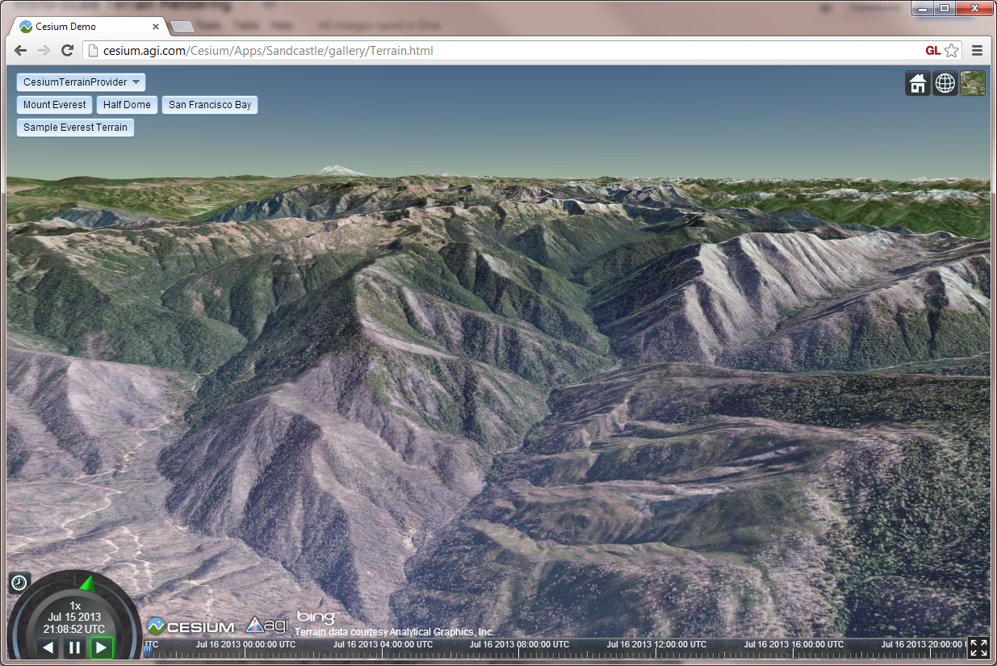
Tile demo
Notes:
Show tiles at different LODs, and how source data of different resolution comes together.

Slide 30
Agenda
LOD algorithm – Chunked LOD
Processing terrain for rendering
Mapping imagery to terrain
Map reprojection on the GPU
Horizon culling

Slide 31
Load Pipeline
Terrain Tile
Imagery Tile
Imagery Tile
Associate Imagery
Request
Upsample
Request
Transform
Transform
Create Texture
Create Resources
Create Resources
Reproject
Notes:
I mentioned before that tiles that we want to render, but that are not yet loaded, are added to a tile load queue. This diagram shows how we process that queue, using our load pipeline. The process starts on the left when we decide we want to bring a new tile into memory. First we figure out which imagery tiles are associated with this terrain tile. I’ll describe how that works next. Then, we kick off these three columns in parallel. We request the tile geometry from the remote server, as well as initiate a request for each imagery tile. These requests proceed asynchronously and will complete at some later time, usually over the course of multiple frames. Meanwhile, we also start the process of upsampling terrain geometry from this tile’s parent. That way, if we receive imagery before we receive terrain, we’ll have geometry with which to render it even before the terrain request completes. When the terrain request does come back, though, we cancel the remaining steps after “Upsample” and instead focus on preparing the better data for rendering.

Slide 32
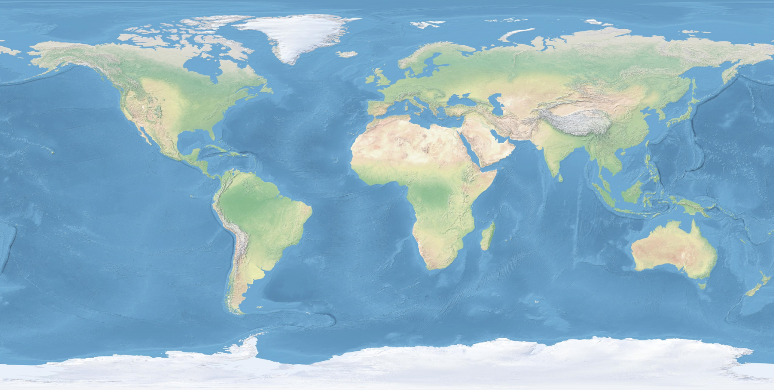
Mapping imagery to terrain
Notes:
You may have noted in the last slide that I said a terrain tile has imagery tiles – plural – associated with it. In a perfect world, every terrain tile would have a single color texture, and life would be simple. But as I mentioned before, Cesium has to deal with the data that is available. So, for each terrain tile, we must compute which imagery tiles apply to it, as well as how to transform them during rendering. There are usually multiple imagery tiles associated with each terrain tile.
First, we determine which quadtree level of imagery applies to the tile. For imagery, we can think of the real-world spacing between texels as our geometric error. Then, we choose a level that maps each texel as closely as possible to a single pixel on the screen. For example, if we’re allowing up to two pixels of screen-space error when selecting geometry, we should select an imagery level with half of the geometric error of the terrain tile in order to guarantee each texel maps to a pixel or less on the screen. If a texel fills more than one pixel on the screen, the imagery tends to look blurry.
With the level selected, we then determine which imagery tiles contain the northwest and southeast corners of the terrain tile – the blue dots shown here. Every tile in the rectangular range defined by those corner points is associated with the terrain tile and passed to the terrain fragment shader as sampler uniforms.

Slide 33
Fragment Shader
Notes:
Here’s a snippet of that fragment shader. This snippet is invoked multiple times, once for each associated imagery texture.
You can see we’re sampling the texture on the second line, but what’s all this other stuff?
Well, the first line transforms the terrain tile’s texture coordinates, which remember I mentioned earlier go from 0.0 to 1.0 linearly with longitude and latitude, to imagery tile texture coordinates by applying a scale and translation passed to the shader as uniforms. I’ll explain how these are computed shortly.
Then there’s this alpha multiplier stuff. It uses more two uniforms, extentMin and extentMax, to control the rectangular extent of the terrain tile that this imagery tile actually applies to. If we’re outside the extent, textureAlpha is 0.0 and this tile will not have any impact on the fragment.
Let me show you how those uniforms are computed.

Slide 34
Texture Scale
imageryHeight
scaleX = terrainWidth / imageryWidth
scaleY = terrainHeight / imageryHeight
imageryWidth
terrainHeight
terrainWidth
Notes:
Here’s our intersecting imagery tiles again, and let’s look at just one of them.
Here’s how we compute that scale uniform. It’s just the terrain tile width and height divided by the imagery tile width and height, expressed in radians of longitude and latitude.

Slide 35
Texture Translation
offsetX
translationX = scaleX * offsetX / terrainWidth
translationY = scaleY * offsetY / terrainHeight
offsetY
Notes:
And the translation is the offset of the imagery tile’s southwest corner from the terrain tile’s southwest corner, expressed as a scaled fraction of the terrain tile’s dimensions. The offset is directional, of course.

Slide 36
Texture Extent
offsetX
extentMinX = offsetX / terrainWidth
extentMinY = offsetY / terrainHeight
extentMaxX = (offsetX + imageryWidth) / terrainWidth
extentMaxY = (offsetY + imageryHeight) / terrainHeight
offsetY
Notes:
And finally, here’s how we compute the range of terrain tile texture coordinates for which this imagery tile applies. We have to be careful with this. For a terrain tile that is completely covered by imagery, the extent of the first imagery texture should start at 0, and the last one should end at 1. Failure to ensure this, due to rounding errors or otherwise, will cause cracks to appear between tiles. Similarly, the maximum texture coordinate of one imagery texture better equal the minimum coordinate of the next, or cracks will appear within the terrain tile.

Slide 37
Fragment Shader
Notes:
Here’s that fragment shader snippet one more time, where you can see how the scale, translation, extentMin, and extentMax are used.

Slide 38
Agenda
LOD algorithm – Chunked LOD
Processing terrain for rendering
Mapping imagery to terrain
Map reprojection on the GPU
Horizon culling

Slide 39
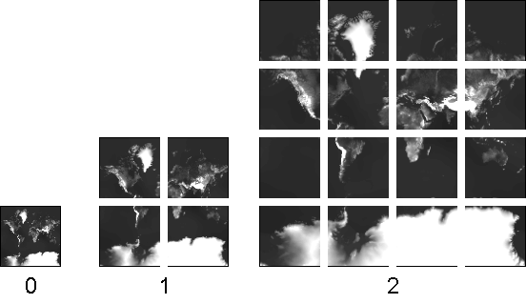
Map Reprojection
Geographic / Plate Carrée (EPSG:4326)
Web Mercator (EPSG:3857)
Notes:
Terrain tile texture coordinates in Cesium are constructed according to the map projection on the left here, such that geodetic longitude and latitude are linear functions of the texture coordinates. This is a pretty common projection, and lots of data is available in this projection. Cesium is a web application, though, and the vast majority of web maps, including Google Maps, Bing Maps, and most of Esri’s newer stuff use this projection on the right, known as Web Mercator Auxiliary Sphere. At first it may seem like an odd choice, because it uses an even more excessive number of pixels near the poles and it can’t represent latitudes above about 85 degrees at all.
The web map guys love this projection, though, because when you draw it in 2D, square buildings look square. Given the vast quantity of imagery available using this projection, we considered it very important that Cesium support it out-of-the-box. The different extents of tiles in the two projections are already handled by the texture scale and translation we just discussed. But within the extent, the mapping between geographic texture coordinates and Web Mercator texture coordinates is not linear. So we need to do something more.
Our approach is to reproject each Web Mercator imagery tile to geographic using the GPU on tile load.

Slide 40
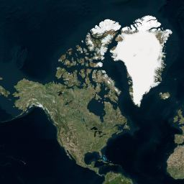
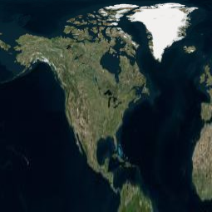
Web Mercator Reprojection
mercatorY = 0.5 * log((1.0 + sinLatitude) / (1.0 - sinLatitude))
mercatorOffset = mercatorY – southMercatorY
mercatorT = mercatorOffset * oneOverMercatorHeight
Notes:
The s texture coordinate is the same in the geographic and Web Mercator projections. In other words, the image varies with longitude in the same way in both projections.
The t texture coordinate is computed as shown here. We compute latitude from the geographic t coordinate, and then take its sine. Next we use this top formula to transform the latitude to a Mercator angle in the range –PI to PI. Then, we subtract the Mercator Y coordinate of the southern edge of tile, which we compute on the CPU and pass in as a uniform. And finally we scale to the range 0.0 – 1.0 by multiplying by the inverse of the difference in the Mercator Y coordinate between the northern and southern boundaries of the tile, again using a value passed as a uniform.
The end result looks like this. In the Northern hemisphere, Northern latitudes get compressed and southern latitudes get stretched.
We do this reprojection on the GPU by rendering to a framebuffer with a color attachment and transforming the geographic texture coordinates to Web Mercator with the equations above before sampling the Web Mercator texture. There are a couple of gotchas with this, however.

Slide 41
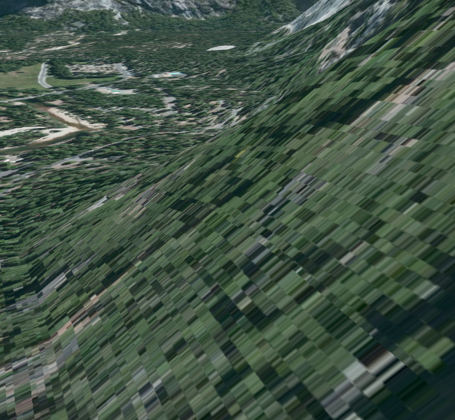
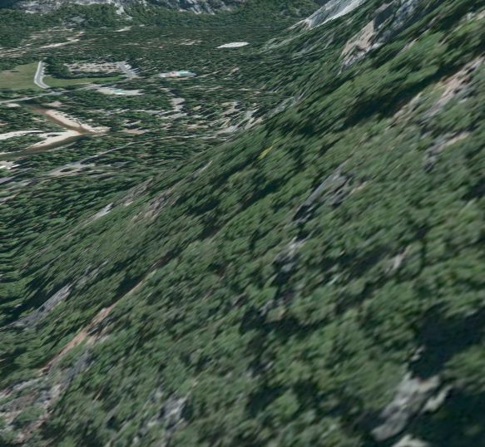
GPU Reprojection Gotchas
Problem: Limited floating-point precision
Solution: Texel spacing cutoff
Notes:
The first gotcha is a common one in massive worlds: the GPU lacks the floating-point precision to do this transformation in all cases. It manifests as blocky artifacts at close zoom levels, as seen in the screen shot on the left. In the screen shot on the right, the problem has been fixed.
Sometimes, we can overcome these sorts of precision problems by using simulated double-precision floating point arithmetic on the GPU. Unfortunately, our reprojection operation requires the transcendental functions log and sine. Simulating double-precision for these functions is, at best, extremely expensive. Instead, we use a much simpler trick. We simply stop doing the reprojection.

Slide 42
Texel Spacing Cutoff
Notes:
What do I mean? Ok, Let’s say we skip the reprojection and assume a Web Mercator image is the same as a Geographic image. We effectively introduce error in the texture coordinates. But how much error? This chart shows the maximum magnitude of that error at any latitude for the first 20 levels of the imagery tile quadtree. As you can see, the error drops sharply as we go deeper in the tree. At level 8, the error is smaller than a texel of a 256x256 image. At level 11, the error is smaller than 1/10 of a texel, which we consider acceptable. Empirically, these block artifacts do not appear until after level 11, so cutting off the reprojection at that level is an effective strategy and the one used by Cesium.
This works great as long as we have something close to 32-bit floating point numbers available. What if we don’t? That’s brings me to the next gotcha.

Slide 43
GPU Reprojection Gotchas
Problem: Many mobile GPUs have limited fragment shader precision.
Solution: Reproject in the vertex shader instead of the fragment shader.
Notes:
Unfortunately, many mobile GPUs don’t even have single-precision floating point arithmetic available to their fragment shaders. On these mobile devices, our strategy so far results in blocky smearing artifacts, like the ones we saw a couple of slides ago. The difference is, these artifacts show up much earlier than level 11, and in fact show up while the reprojection has a very noticeable impact on the imagery. We can’t just cut off the projection earlier on these devices. So what do we do?
Our solution is to compute the texture coordinates in the vertex shader instead of in the fragment shader. Conveniently, even mobile GPUs, at least the relatively recent ones, have reasonable precision in their vertex shaders. In order to do this accurately, we need to ensure that we have one vertex per output texel, or a grid of 256x256 vertices for a 256x256 output image. Using the obvious approach of computing the reprojected texture coordinates in the fragment shader, we only need 2x2 vertices. Fortunately, the vertex buffer is shared and unmodified for all reprojections. In addition, our fragment shader becomes trivial with this modified approach, so overall the performance is very similar to the original approach on desktop systems and has the rather nice benefit of producing correct results on mobile devices.

Slide 44
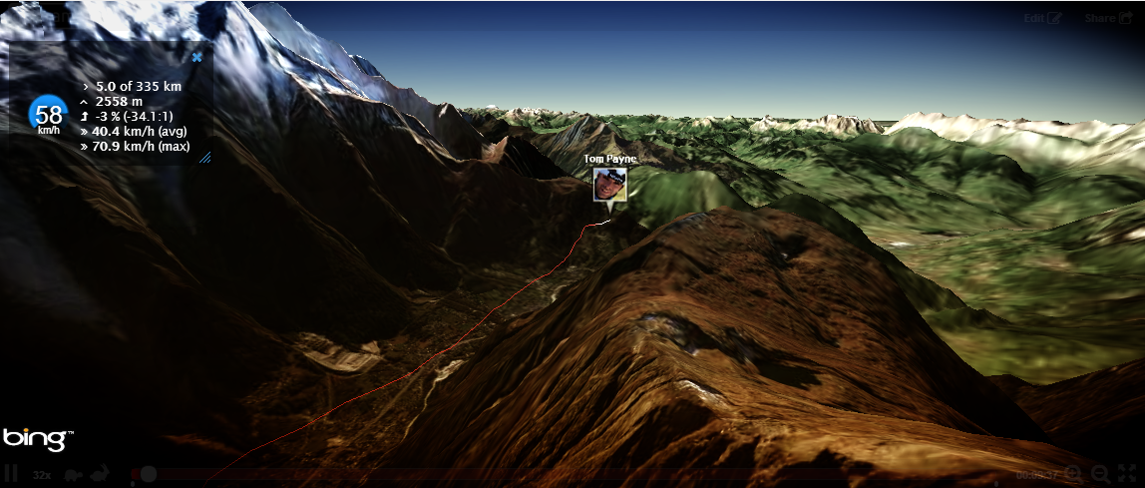
Doarama demo

Slide 45
Agenda
LOD algorithm – Chunked LOD
Processing terrain for rendering
Mapping imagery to terrain
Map reprojection on the GPU
Horizon culling

Slide 46
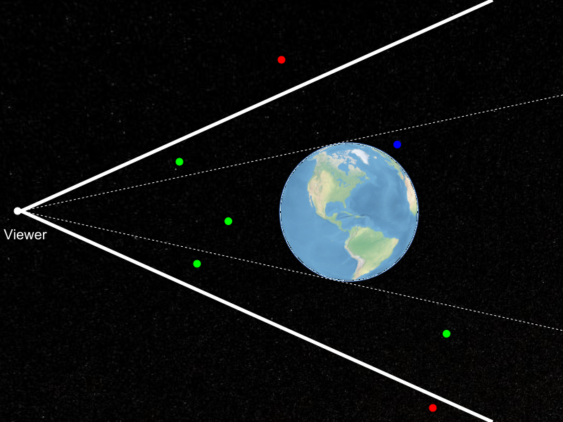
Horizon Culling
Notes:
Horizon culling is a form of occlusion culling that is very effective for any spherical or ellipsoidal massive world. Ellipsoids are important because WGS84, a very common, idealized model of the shape of the Earth, is an ellipsoid, In this picture, terrain tiles covering the entire Earth lie inside the view frustum, represented as heavy white lines. The red points are not visible because they are outside the view frustum. The green points are visible. And the blue point is inside the view frustum, but it is not visible to the viewer because it is occluded by the Earth. Horizon culling aims to separate the green points from the blue ones. We have formulated a novel and very efficient test for determining if a tile is below the horizon of an ellipsoid.
By doing horizon culling as well, instead of just view-frustum culling, we reduce the number of tiles rendered by as much as 50% for common views.

Slide 47
Ellipsoid-scaled space
Ellipsoid
WGS84 | Length (meters)
a | 6,378,137.0
b | 6,378,137.0
c | 6,356,752.314245
x, y, z is any position on the surface of the ellipsoid
a, b, c are ellipsoid semi-axis lengths
Ellipsoid-scaled space:
Is centered on the ellipsoid
Axes are aligned with ellipsoid axes
Ellipsoid is a unit sphere.
Scale to ellipsoid-scaled space:
[Cozzi10]
Notes:
Our horizon culling technique requires us to work in the ellipsoid-scaled space. This is a coordinate system that is centered on the ellipsoid, that has axes aligned with the ellipsoid’s axes, and in which the ellipsoid itself is represented by the unit sphere. That may sound like a lot of requirements, but for a virtual globe application like Cesium, the coordinate system used for rendering probably already meets the first two requirements. The last one is achieved by multiplying coordinates by the scaling matrix shown here.

Slide 48
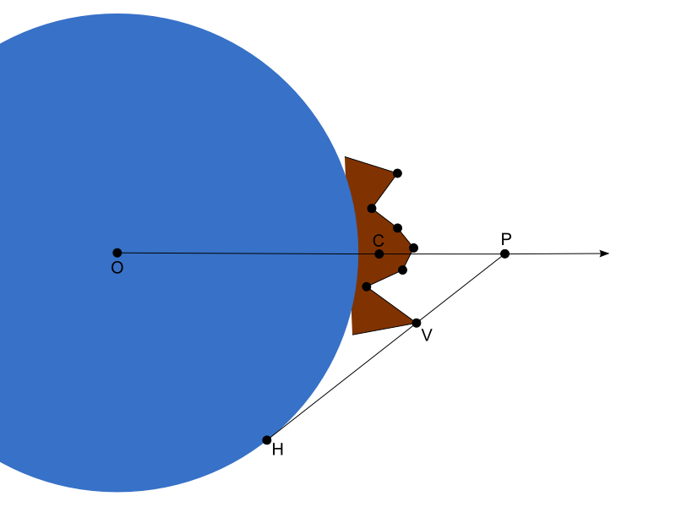
Horizon occlusion point
[Ring13b]
Notes:
In this diagram, the Earth is the blue sphere and a terrain tile is shown in brown. Let’s compute what we call the horizon occlusion point for this tile. The horizon occlusion point is a point with a useful property: when the point is below the horizon, the entire tile is below the horizon as well.
Vector OC is a vector from the center of the Earth to the approximate center of the tile. We’re going to make the executive decision that our horizon occlusion point, P, will lie along this vector. So really, we just need to compute the magnitude of point P.
You can see from the diagram that point P is the intersection of vector OC with vector HV. Point V is a vertex in the terrain tile. Point H is a point on the horizon from the perspective of point V. There are actually an infinite number of horizon points, but only two of them form vectors that intersect with vector OC. One of those two vectors is shown in this diagram. The other would intersect with vector OC before passing through point V, so the intersection will be closer to the ellipsoid, so we’re not interested in that one.

Slide 49
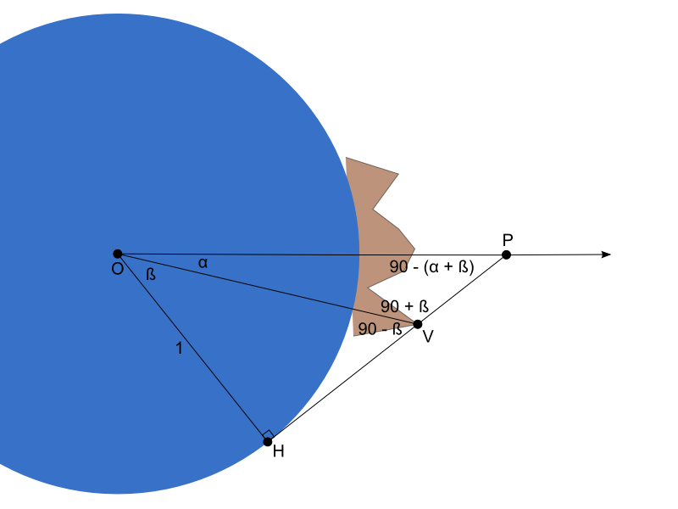
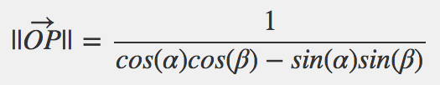
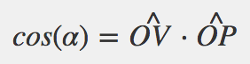
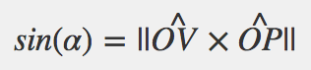
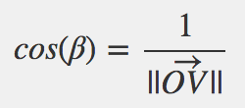
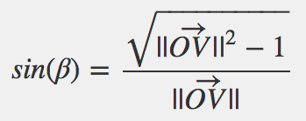
Horizon occlusion point
[Ring13b]
Notes:
If we label the angles in this diagram, we start to see how we can solve for the magnitude of vector OP. I walk through the full derivation in the blog post referenced here, but I’ll skip that here in the interest of time. It all boils down to this top equation, where the sine and cosine terms are computed as shown.
We repeat this computation for every vertex in the terrain tile mesh, and then choose the magnitude of OP is that greatest, and that becomes our horizon occlusion point for the tile. Ideally we would do this computation in a terrain pre-processing step, but it’s cheap enough that we can reasonably do it on tile load as well.
Remember, the occlusion point is represented in the ellipsoid-scaled space. This is actually convenient for testing the point for occlusion by the ellipsoid.

Slide 50
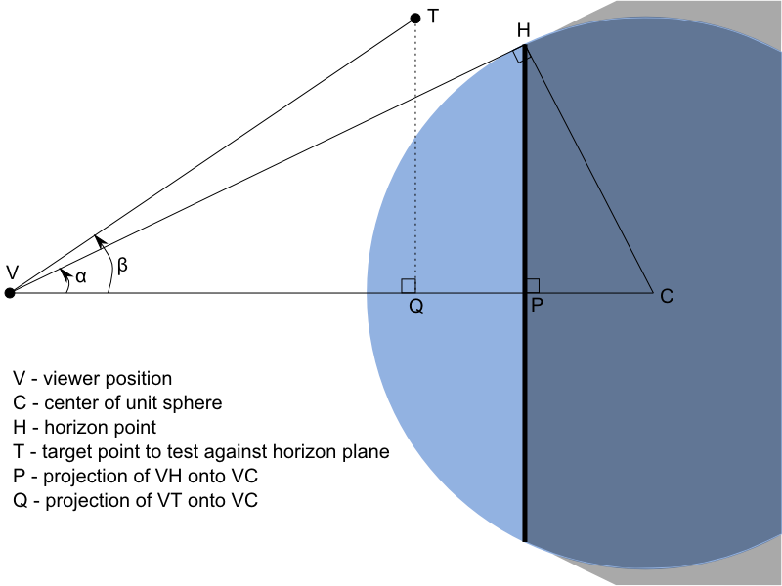
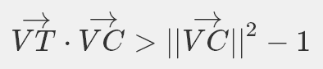
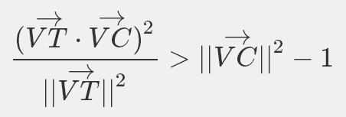
Testing the occlusion point
Plane Test:
Cone Test:
[Ring13a]
Notes:
Now, we’ve constructed this point such that if it is occluded, then the entire tile is occluded as well and we can skip rendering it. So how do we test the point for occlusion?
Again the full derivation is in the cited blog post, but it boils down to two inequalities. The first tests if the point is behind the plane shown with a dark line in this diagram. If the point is in front of this plane, then it is not occluded by the ellipsoid and we’re done. If it is behind the plane, we apply the second test.
The second test determines if the point is inside the cone formed by connecting lines from the viewer to the infinite number of ellipsoid points that form the viewer’s horizon. If the point is inside that cone, it is occluded by the ellipsoid. Otherwise, it is not.
These tests do not require any transcendental functions, so they’re very fast. And it also significantly reduces the number of tiles we need to render.

Slide 51
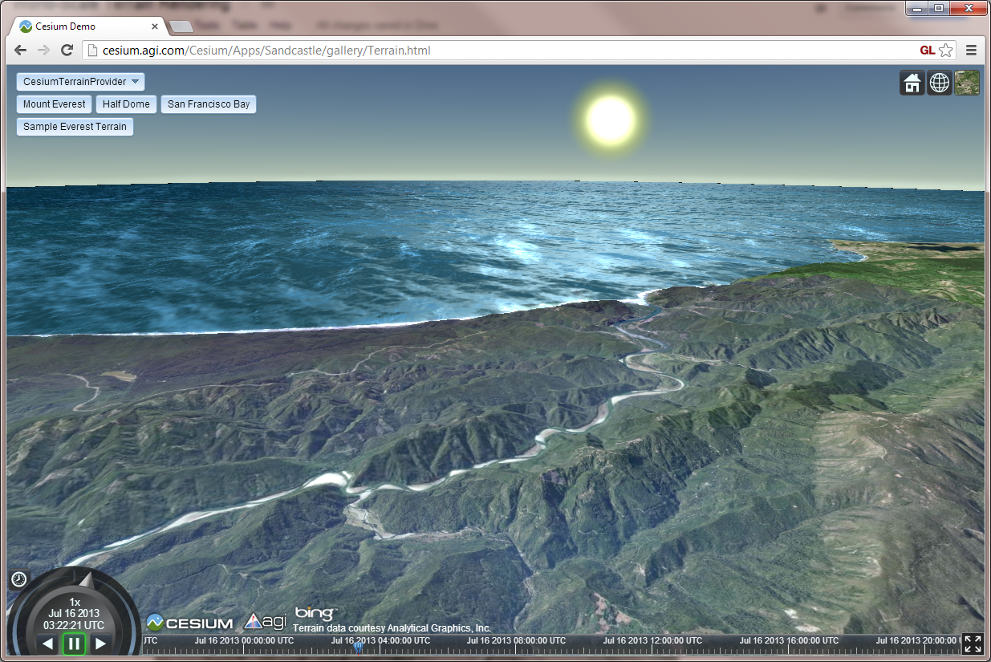
Horizon culling demo

Slide 52
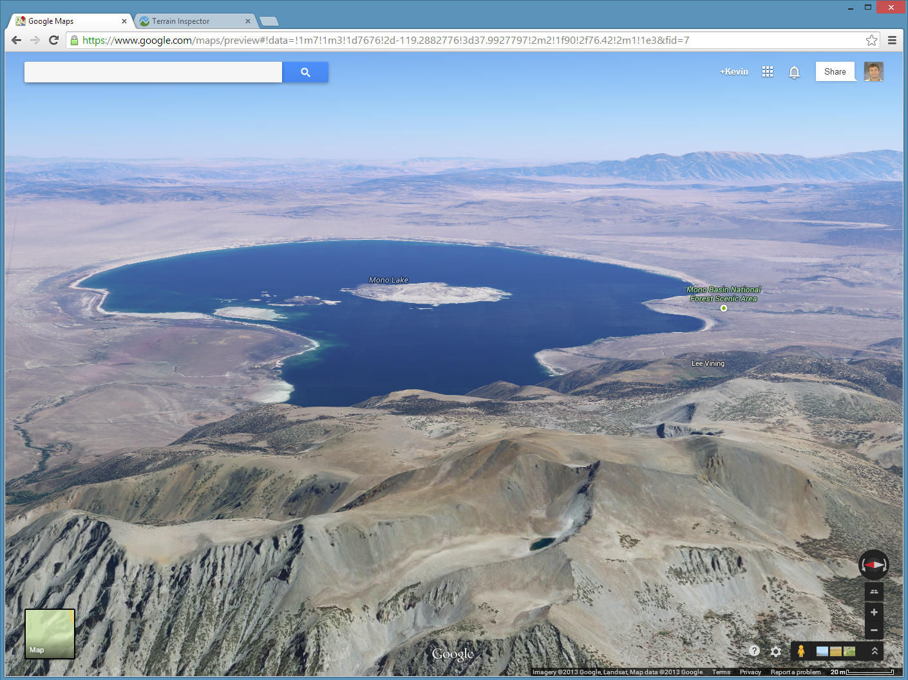
Cheating
Notes:
Horizon culling lets us skip rendering tiles that are far away and thus below the horizon. There’s also another, slightly cheating, way of doing it, and that is to show fog. Cesium doesn’t use fog currently, so this is a screen shot from the new 3D Google Maps. Terrain in the distance is increasingly obscured by the fog, so tiles beyond a certain distance simply don’t need to be rendered at all.
I call this cheating, and I once told a developer on the Google Maps team as much. He said, “maybe, but it’s realistic!” And he’s right. We’ve mostly avoided doing it in Cesium due to our history in visualizing satellite and aircraft systems. Would a marker for a satellite, or a line showing its path, be obscured by fog as well? Probably not, because it would eventually be invisible and the whole point of the app is to show where those things are. On the other hand, rendering some parts of the scene with fog and some without might mislead the eye about their relative distances from the viewer, which would be bad as well. Still, we might give in and add some fog to Cesium eventually, at least as an option.

Slide 53
Acknowledgements
Frank Stoner
Scott Hunter
Notes:
I’d like to thank Frank Stoner for working out this horizon culling technique and for patiently explaining it to me.
I’d also like to thank Scott Hunter for his work on the implementation of the terrain and imagery engine presented here, as well as his help in writing up the details of how it works.

Slide 54
Open problems
Placing lines, polygons, etc. on terrain
Shadows casted by and casted onto terrain
Faster faster faster!
Lighting imagery – it’s usually already lit!
Notes:
A quick note about a few open problems. This is where I try to convince you that there are challenging, interesting, and valuable problems to be solved in the world of Cesium, and smart folks like all of you should join us in working on them.
First, rendering terrain is one thing, but placing other objects on it, like lines and polygons, is pretty hard. The problem is that the terrain shape shifts when the LOD changes. A line that is on the surface at one level of detail could be under or above it at another. The Google Maps guys, cheaters that they are, render their surface lines as imagery to get around this problem, but I’m sure we can do better.
Then there are shadows. Making your massive terrain cast shadows, as well as receive them, is likely to be challenging.
And of course there are endless opportunities for optimization. Cozzi always makes fun of me, telling me how much my slow terrain code is slowing down Cesium. Help me make it better.
And then there’s the challenge of lighting imagery. Satellite and aerial imagery is already lit, in the sense that it is a picture of the real world, and the real world is lit. But we’d like to be able to light terrain based on the time of day or the position of the sun and moon. How can we do that?

Slide 55
Final Thoughts
Cesium is open source, join us!
http://cesiumjs.org
Thanks for listening!

Slide 56
References
[Cozzi10] Patrick Cozzi and Frank Stoner. 2010. GPU ray casting of virtual globes. In ACM SIGGRAPH 2010 Posters (SIGGRAPH '10). ACM, New York, NY, USA, , Article 128 , 1 pages.
[Garland95] Garland, Michael, and Paul S. Heckbert. 1996. Fast Polygonal Approximation of Terrains and Height Field. Technical Report CMU-CS-95-181, Carnegie Mellon University.
[Klein96] Reinhard Klein, Gunther Liebich, and Wolfgang Straßer. 1996. Mesh reduction with error control. In Proceedings of the 7th conference on Visualization '96 (VIS '96), Roni Yagel and Gregory M. Nielson (Eds.). IEEE Computer Society Press, Los Alamitos, CA, USA, 311-318.
[Ring13a] Kevin Ring, Frank Stoner. Horizon culling. 2013.
[Ring13b] Kevin Ring, Frank Stoner. Computing the horizon occlusion point. 2013.
[Ulrich02] Thatcher, Ulrich. Rendering Massive Terrains Using Chunked Level of Detail Control. In SIGGRAPH 2002 Super-Size It! Scaling Up to Massive Worlds Course Notes. New York: ACM Press, 2002.

